Slide 1
Programming Environment and Package Installation
Programming for Data Analysis (CT127-3-2-PFDA and Version VC1)
Copyright 2016 Asia Pacific Institute of Information Technology

Slide 2
Topic & Structure of the lesson
Overview of
- R Programming Language
- R Environment
-Packages
-Install and Uninstall
-Load and Unload

Slide 3
Learning Outcomes
At the end of this topic, you should be able to:
Understand the R environment
Understand the different packages used in the RStudio

Slide 4
Key Terms you must be able to use
If you have mastered this topic, you should be able to use the following terms correctly in your assignments and exams:
Rstudio
Packages

Slide 5
What is R ?
R is a programming language developed by Ross Ihaka and Robert Gentleman in 1993.
R is commonly used in statistical computing, data analytics and scientific research.
It is one of the most popular languages used by statisticians, data analysts, researchers and marketers to retrieve, clean, analyze, visualize and present data.

Slide 6
Why use R ?
R is open Source and free
R is popular – and increasing in popularity
R runs on all platforms
Learning R will increase your chances of getting a job

Slide 7
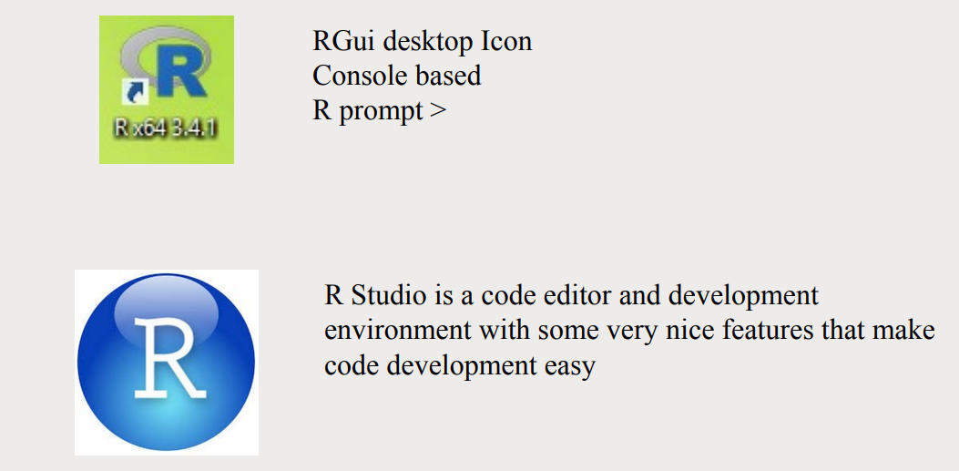
R Environment

Slide 8
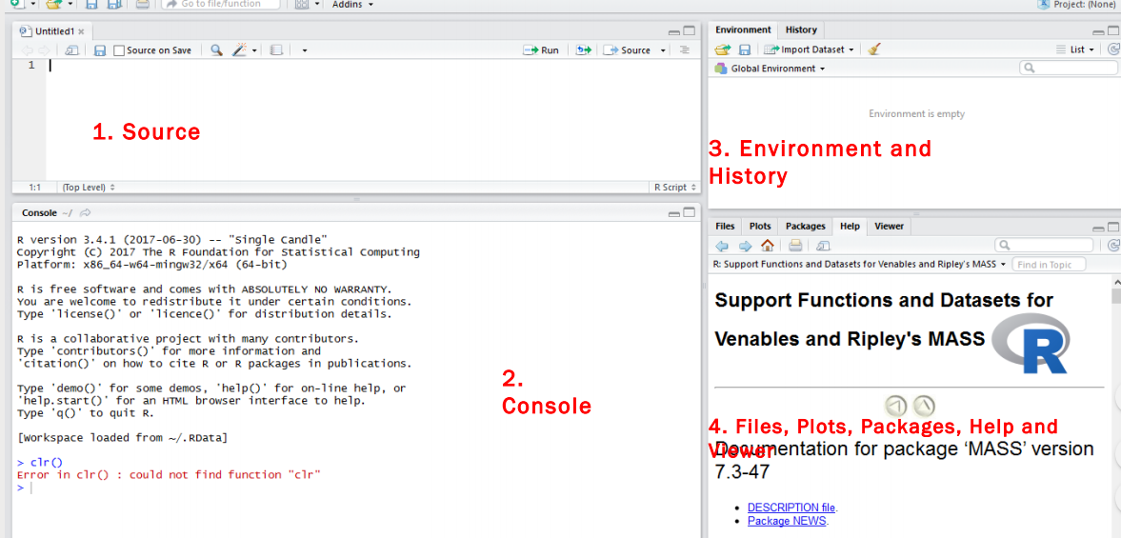
R Environment

Slide 9
Source
- Top left corner of the screen contains a text editor that lets you work with source script files.
- Here, you can enter multiple lines of code, save your script files to disk, and perform other tasks on your script.
Console
- This is where you do all the interactive work with R.
Environment and History
Here you can inspect the variables you created in your session, as well as their values.
Files, plots, package, help, and viewer
- Here you can see the files upload, graphs generated, Help option, package description

Slide 10
R Package
A package is essentially a library of pre-written code designed to accomplish some task or a collection of task.
CRAN,the official repository maintained by R community
There were 4,845 packages available on CRAN,written by an estimated 2,000 people.
Eg: ggplot2 is used for plotting the graph
sp is used for dealing with spatial data

Slide 11
Installing Packages
The simplest is to install them using the GUI provide by Rstudio.
Access packages by clicking its tab or ctrl+7 on the keyboard
An alternative is to type
>install.packages(“coefplot”)
For uninstalling packages
>remove.packages

Slide 12
Loading Packages
After installation,the packages need to be loaded first.
The commands used are library or require
For loading a package
>library(coefplot)
>require(coefplot)
For unloading packages
>detach(“package:coefplot”)

Slide 13
Quick Review Question
What is an environment in R ?
What is Packages?
Explore some sample packages
How to install and load a package?

Slide 14
Summary of Main Teaching Points
R programming
R Environment
Packages
Install and Load Packages

Slide 15
Question and Answer Session
Q & A

Slide 16
Next Session
Basics of R Programming

